Slide 1

Chinese Culture and Art Exploration Platform
Project Member
Student 1: Huang Jiarui ID: 3036382301
Student 2: Ji Ruishu ID: 3036382038
Student 3: Li Peiying ID: 3036450237

Slide 2
CONTENTS
01
Introduction
02
Progress Update
03
Requirements Gathering
04
Platform UI Design
05
RAG Research
06
Next Steps

Slide 3
PART 01
Introduction

Slide 4
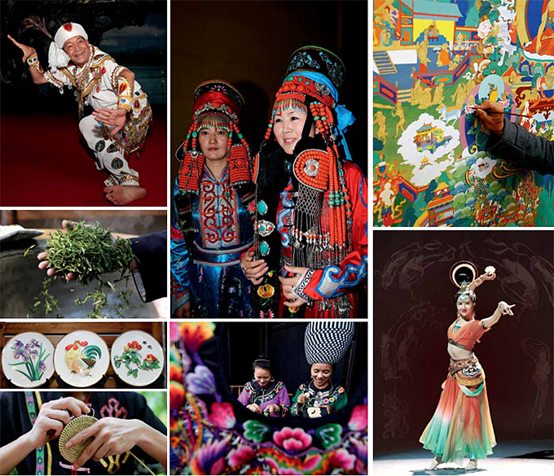
Motivation and Objective
- The importance of culture and art: Under the background of globalization and digitalization, the communication and exchange of culture and art have become particularly important.
- Lack of existing platforms: There is a lack of a cultural and artistic platform on the market that can meet the diverse needs of users.
- Trends in digital transformation: Digital platforms can effectively enhance the dissemination and participation of culture and art, and enhance the interactive experience of users.
- The need to protect cultural heritage: Cultural heritage is at risk of disappearing and forgetting, and the platform can promote public attention and dissemination of cultural heritage.
Chinese Culture and Art
Objective:
Create an integrated platform including cultural and artistic works display, activity participation, intelligent Q&A model, user interaction and other functions to meet the requirements of users.

Slide 5
PART 02
Progress Update

Slide 6
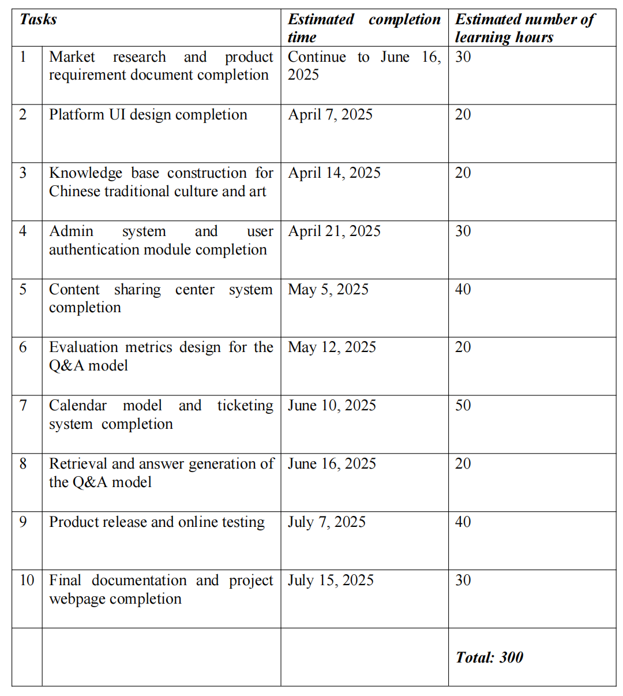
Milestones

Slide 7
Achieved Key Milestones
1
User Requirements Gathering
Completed Task
2
Platform UI Design
3
RAG Research

Slide 8
PART 03
Requirements Gathering

Slide 9
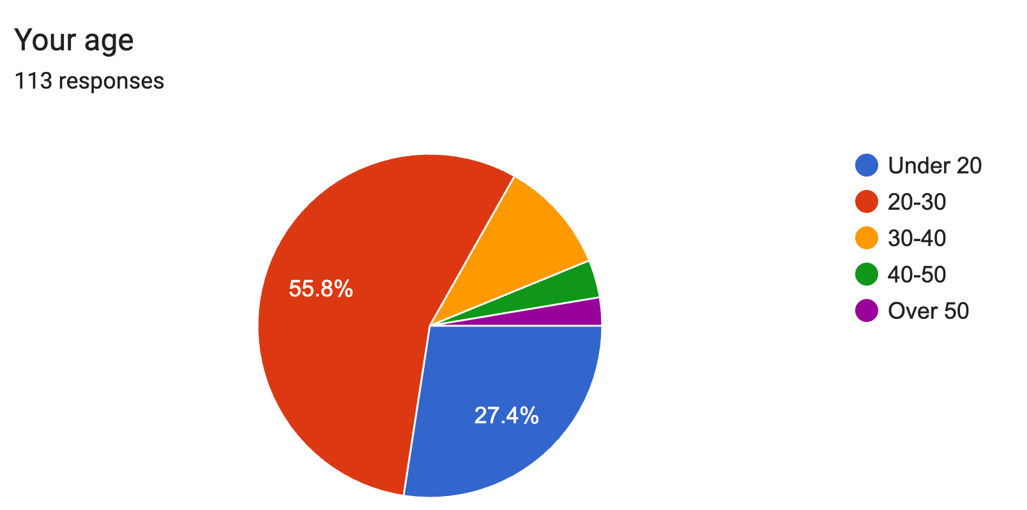
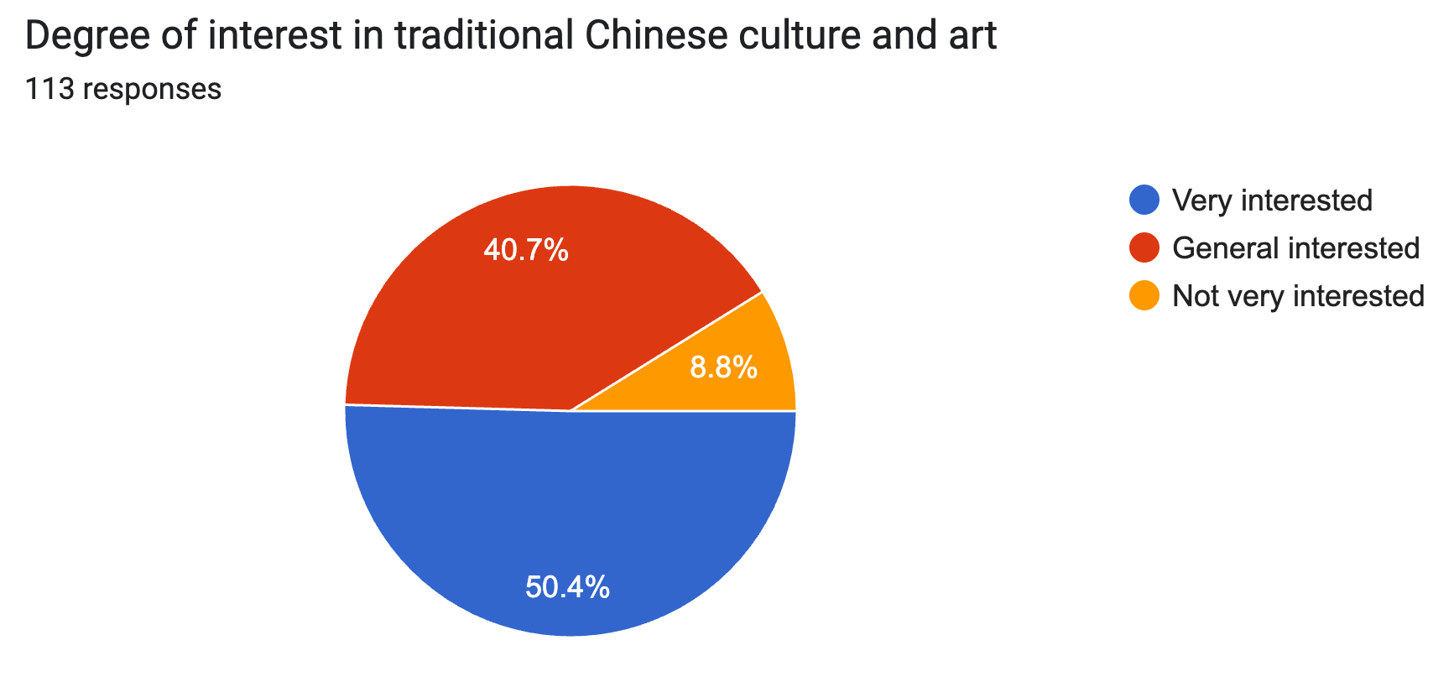
Questionnaire user profile analysis
Sample Size: 113 valid survey responses
Age Group:
- Covered different age groups
- Majority are under 40 years old
Cultural Interest:
- 91.2% are either very interested or generally interested in traditional Chinese culture
- Only 8.8% showed low interest
Conclusion:
- Users have strong cultural interest, which provides a solid foundation for the platform.

Slide 10
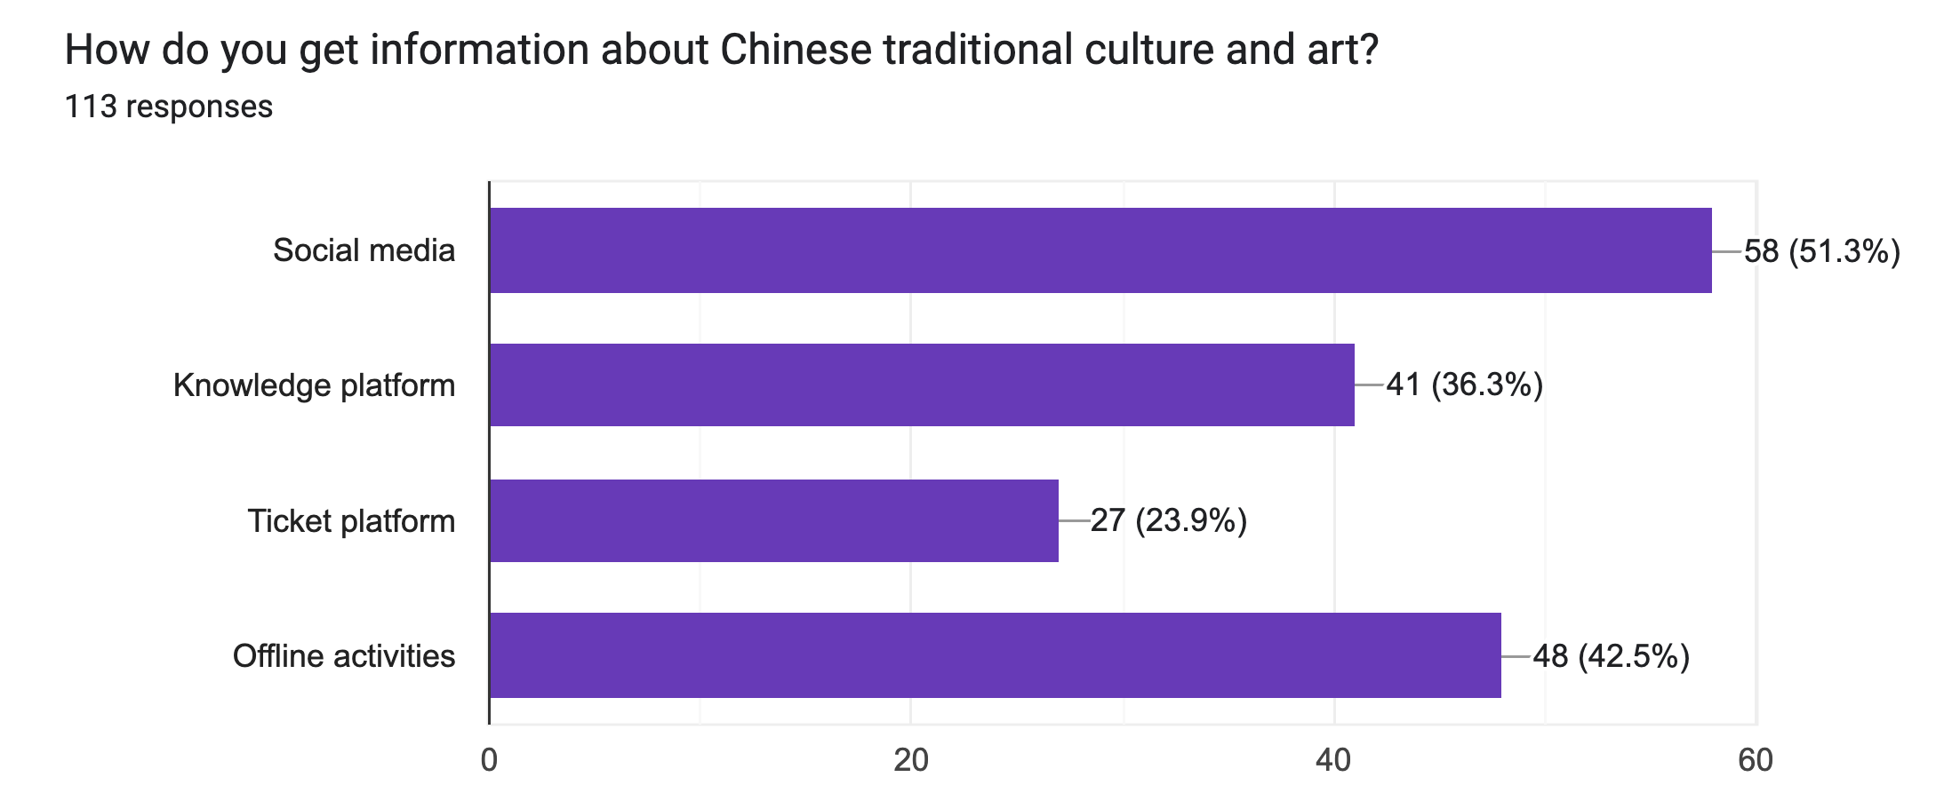
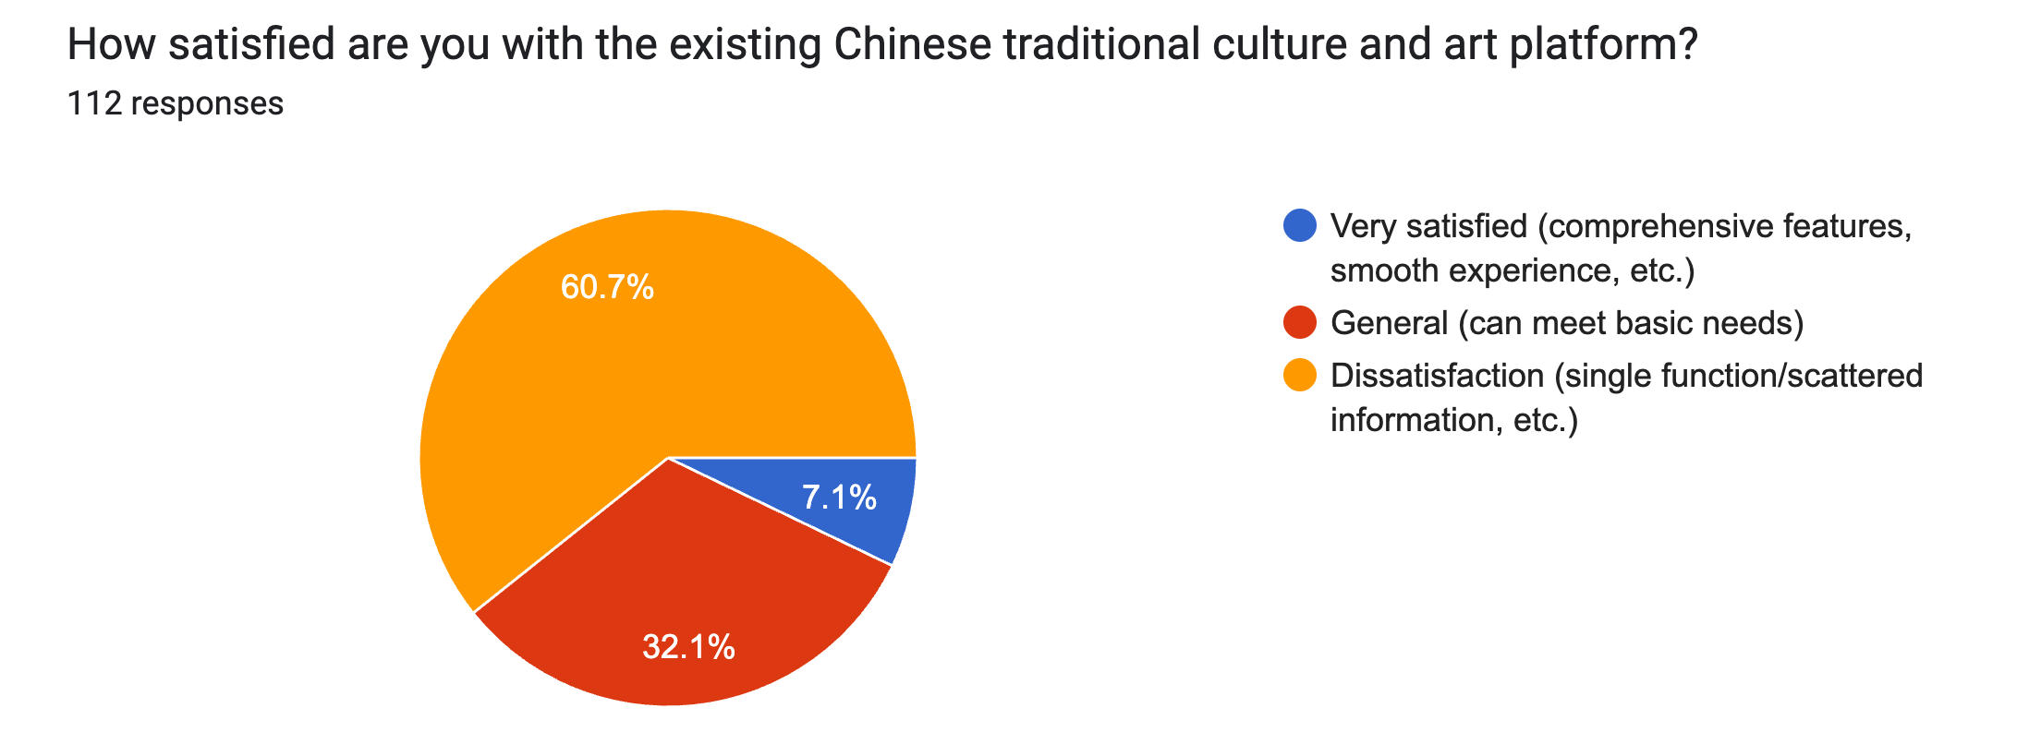
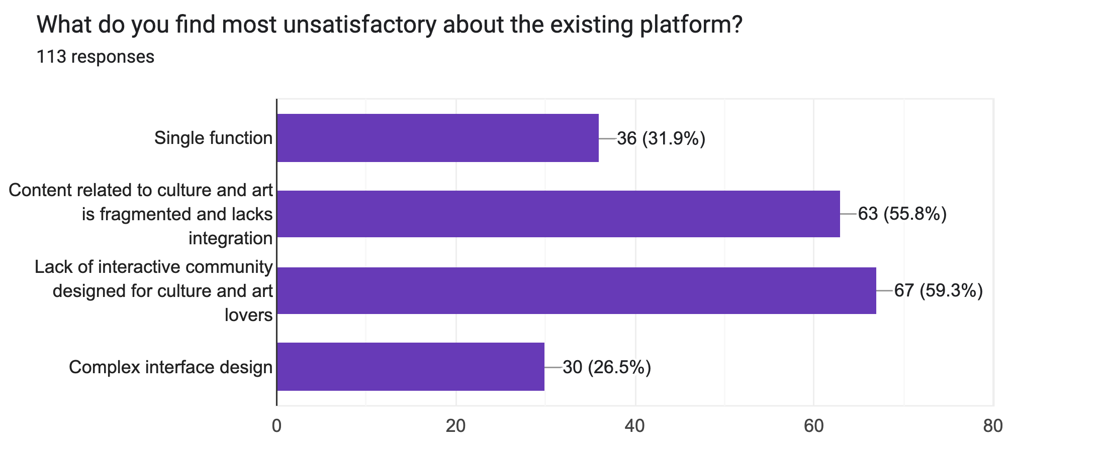
Pain Points and User Expectations
Satisfaction with Existing Platforms:
- 60.7% are dissatisfied
- Only 7.1% are very satisfied
Pain Points Identified:
- Lack of specific community
- Scattered content
- Limited features
- Complex user interface
Conclusion：
- Users seek a centralized, interactive, and social platform experience.

Slide 11
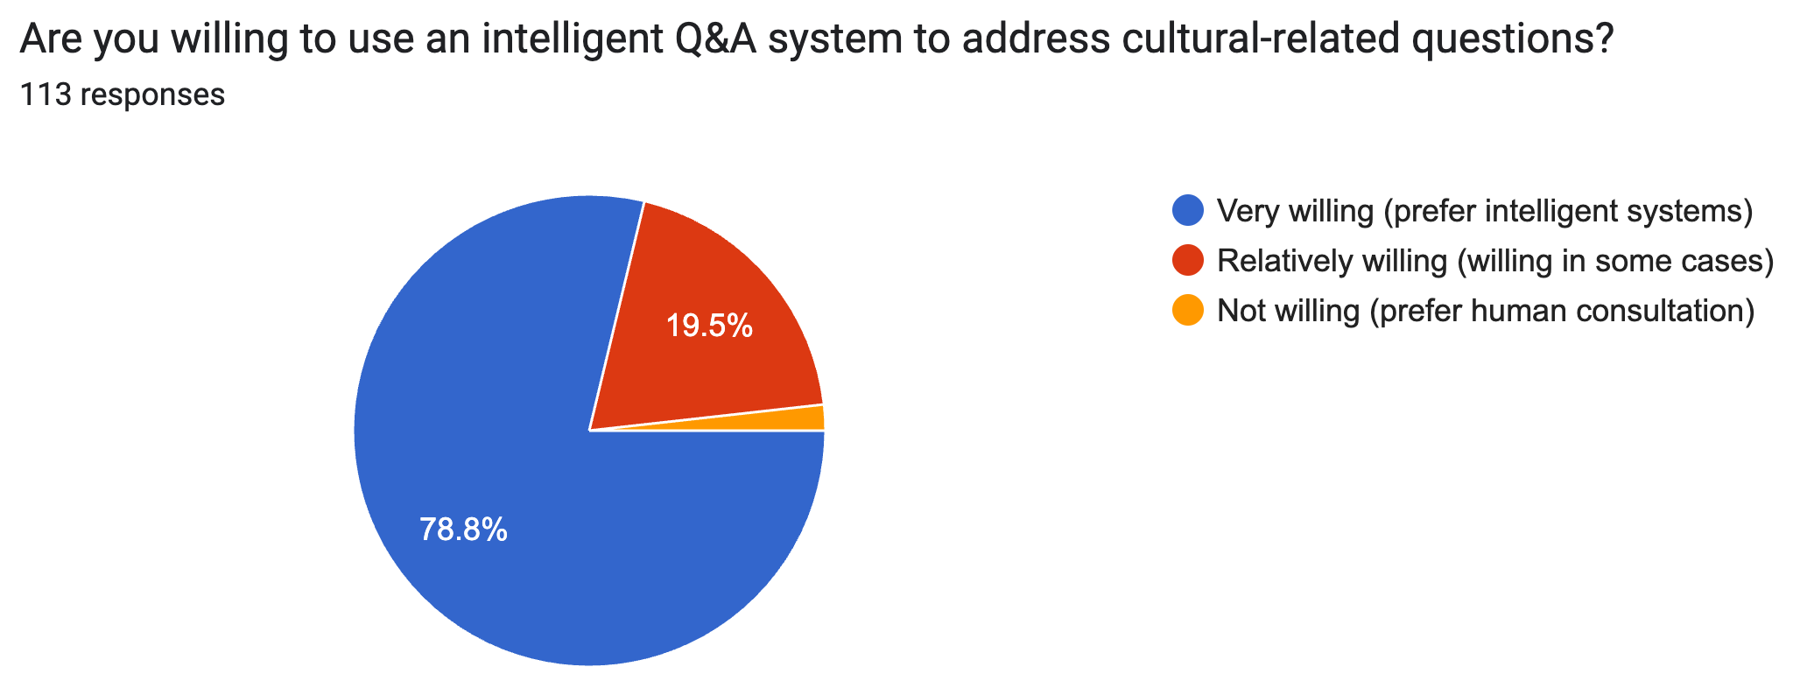
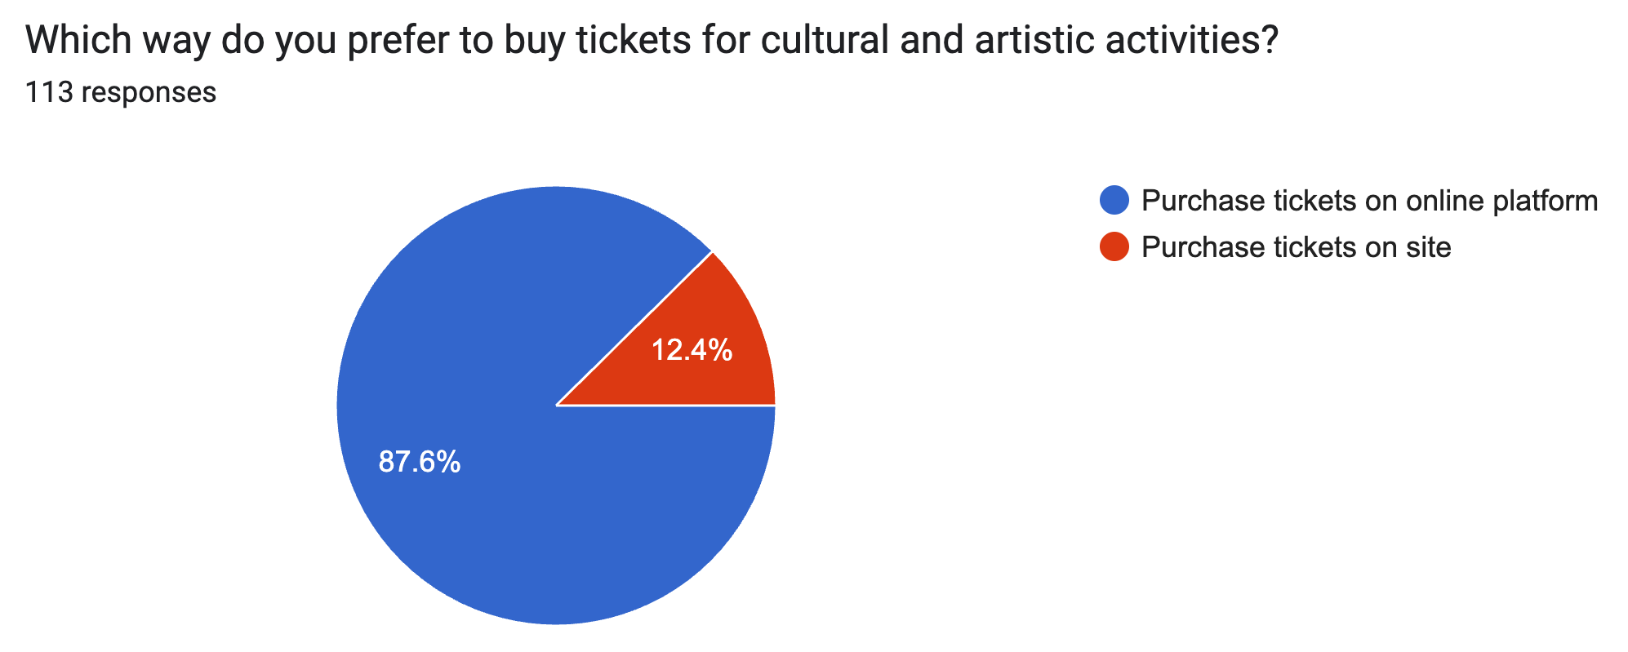
Demand for intelligent Q&A functions and online ticketing systems
Smart Q&A System Acceptance:
- 78.8% are very willing to use it
- 19.5% are somewhat willing
Ticketing Preferences:
- 87.6% prefer online ticket purchasing
- Only 12.4% still prefer on-site
Conclusion:
- The introduction of intelligent question answering system and digital ticketing system is the key function to improve user satisfaction and platform competitiveness.

Slide 12
PART 04
Platform UI Design

Slide 13
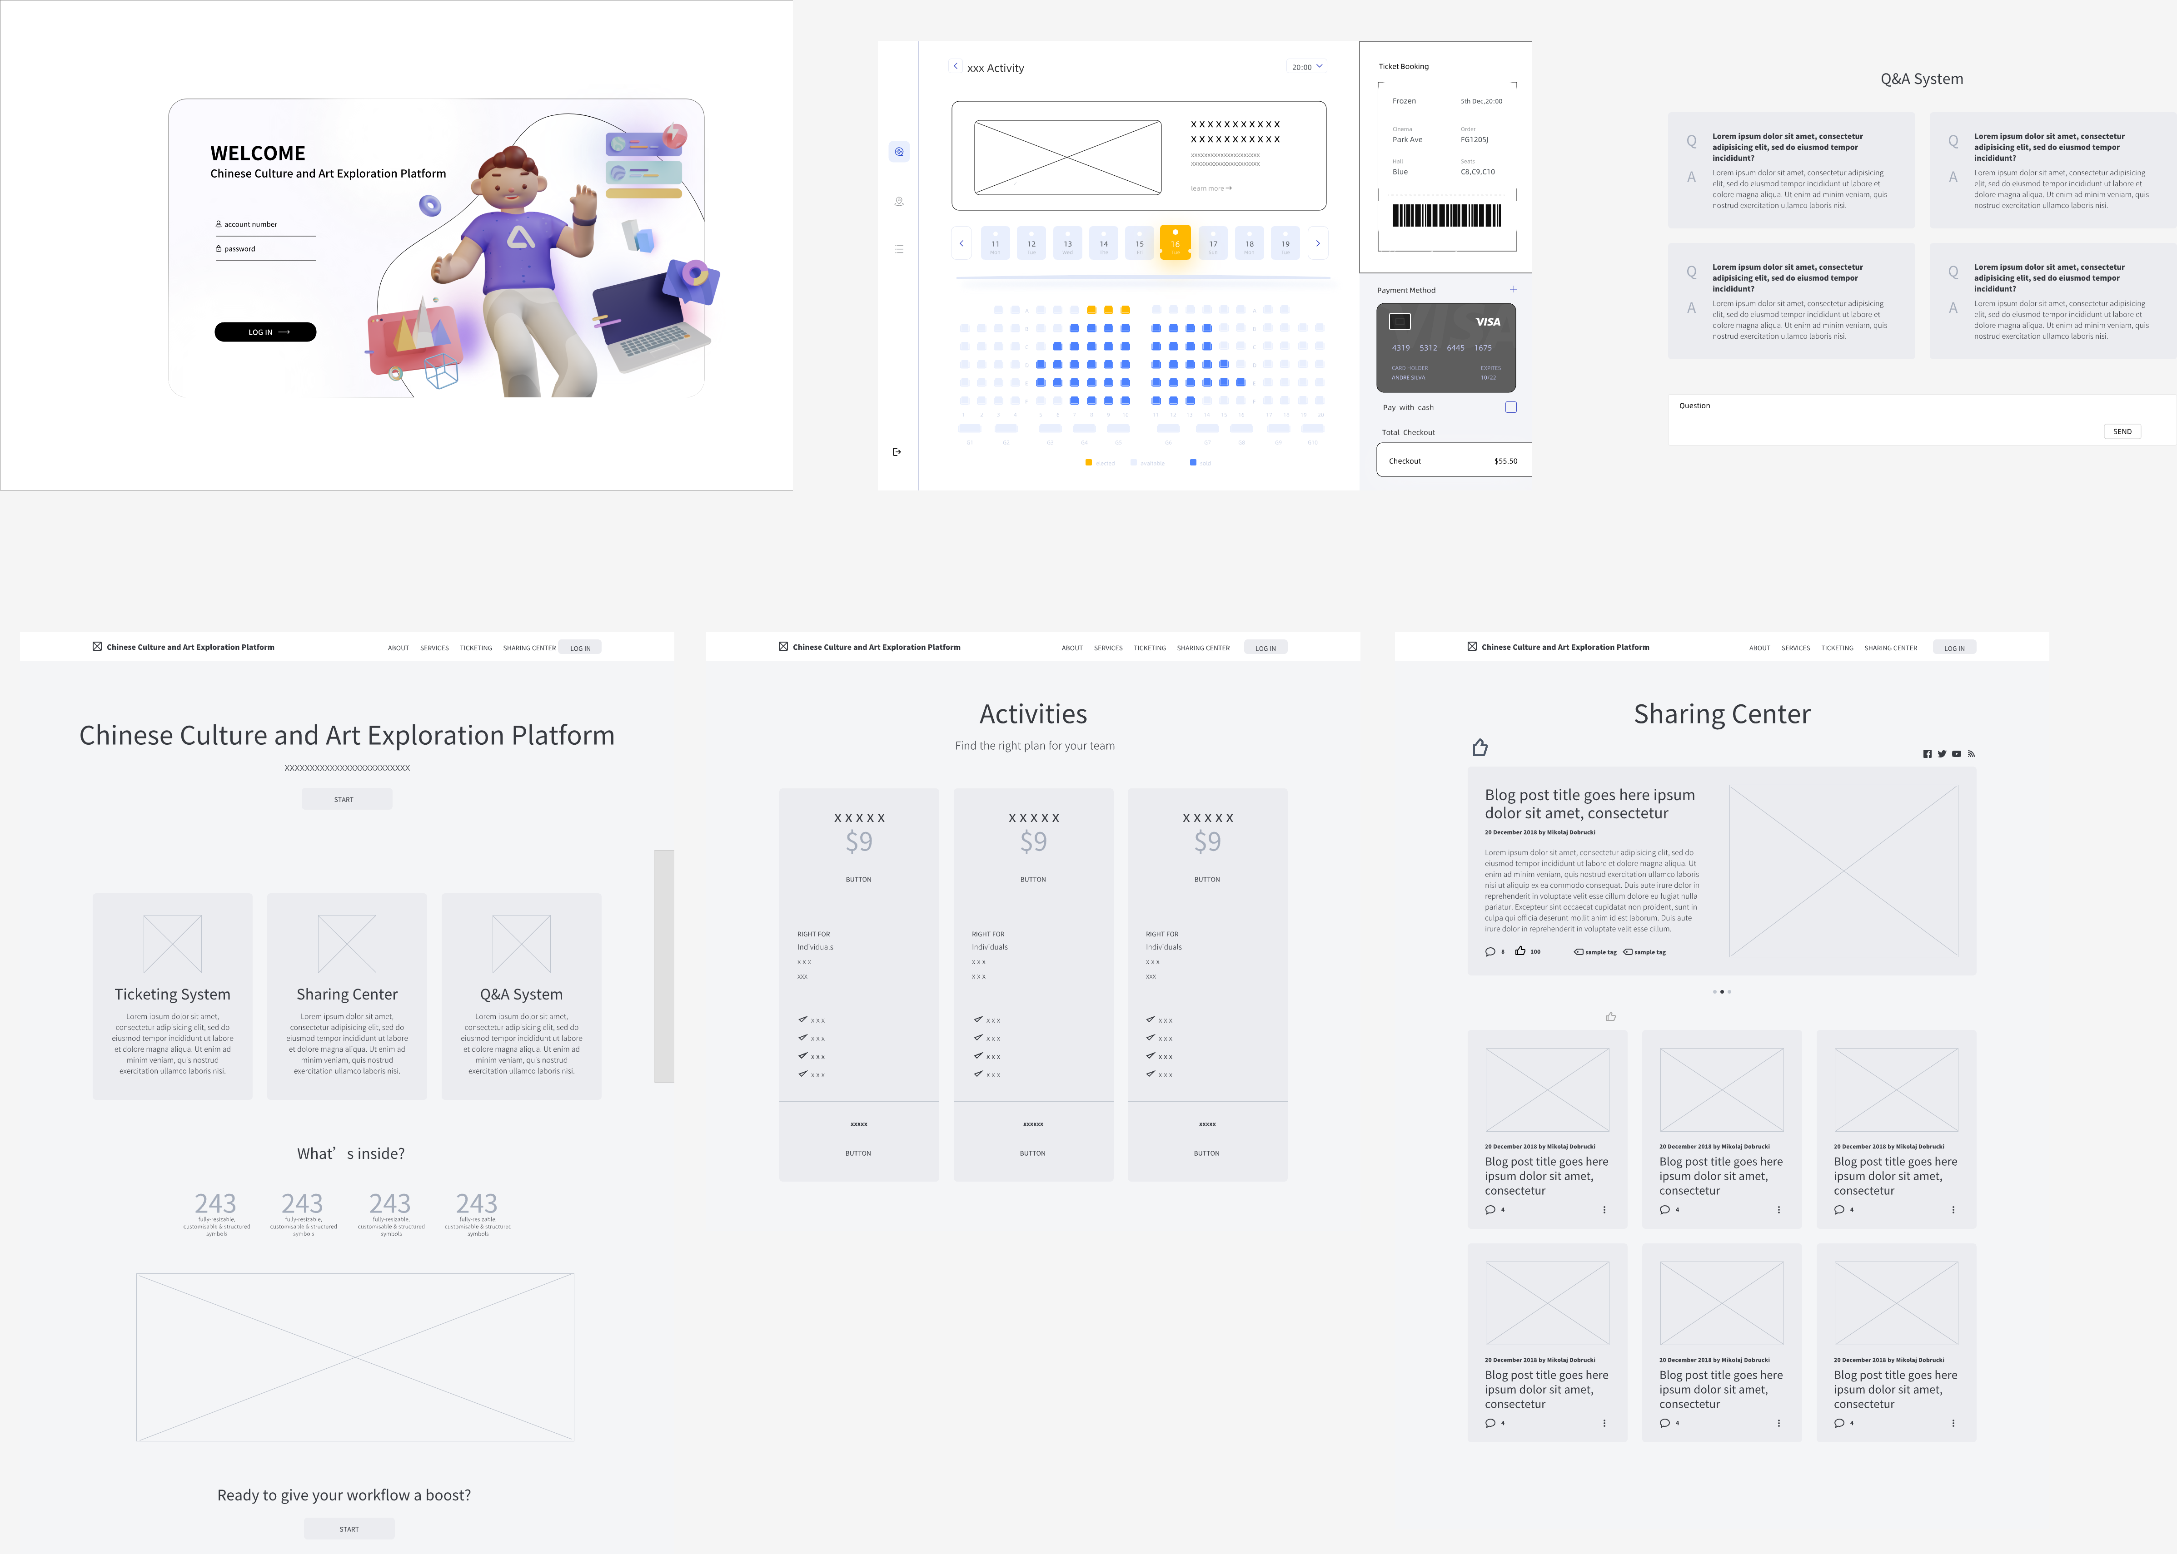
Platform UI design

Slide 14
PART 05
RAG Research

Slide 15



RAG principle and novelty
Principle
novelty
Combining the retrieval mechanism with the generation model, similar to a search engine, the retrieval of relevant knowledge is integrated into the prompt to guide the LLM output.
Alleviate the LLM illusion problem and ensure the accuracy of facts;
Connect to private knowledge bases to ensure data privacy and security;
Dynamically obtain the latest information.

Slide 16
Application of RAG in the platform
01 Knowledge preparation
Various cultural documents conversion to text,
Segmentation processing,
Embedding vectors,
Embedding database construction.
02 Optimization strategy
Best model selection,
Parameter adjustment.
03 Evaluation indicators
Generation indicators: Rouge, BLEU, etc.
Embedding evaluation.

Slide 17
PART 06
Next Steps

Slide 18
Next Steps
1
Complete Key Requirement Identification and Specifications
2
Complete the Admin system and user authentication module
Upcoming Milestones
3
Complete the Content sharing center system
4
Embedding store construction for Chinese traditional culture and art

Slide 19
Thank You！

